Slide 1
18F + agile
Shashank Khandelwal

Slide 2
18F is a digital consultancy for the U.S. Government, inside the U.S. Government.

Slide 3
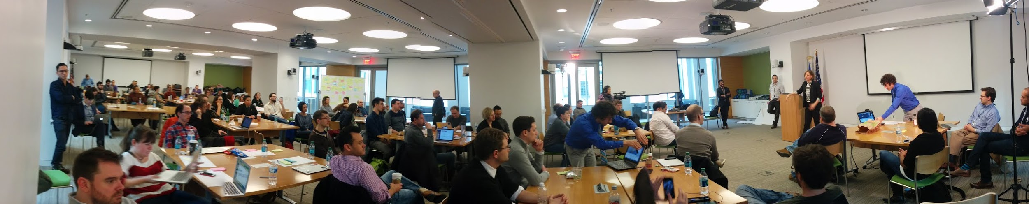
We’re designers, developers, user experience experts and content and product specialists.

Slide 4
We want to create great services for the American people.

Slide 5
Putting the needs of the American people first

Slide 6
Being design-centric, agile, open, and data driven

Slide 7
Deploying our products early and often

Slide 8



Slide 9
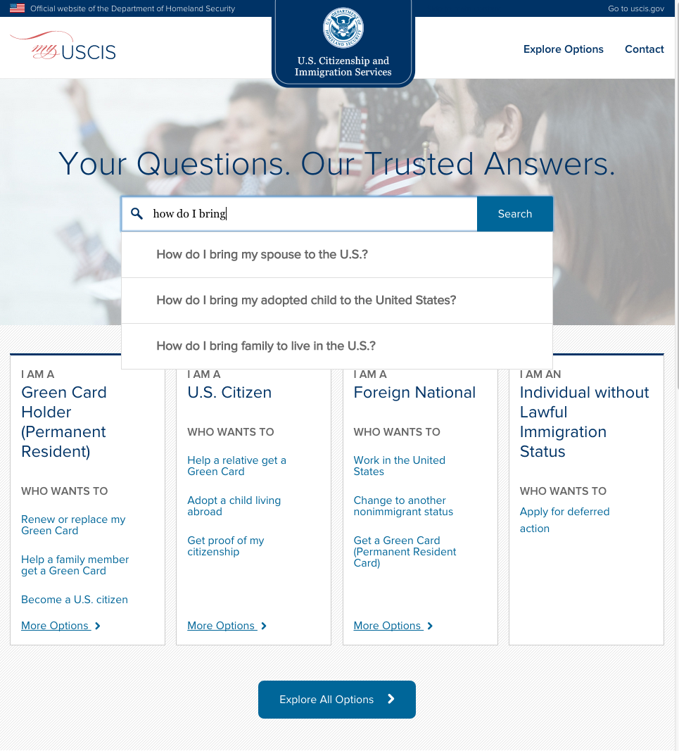
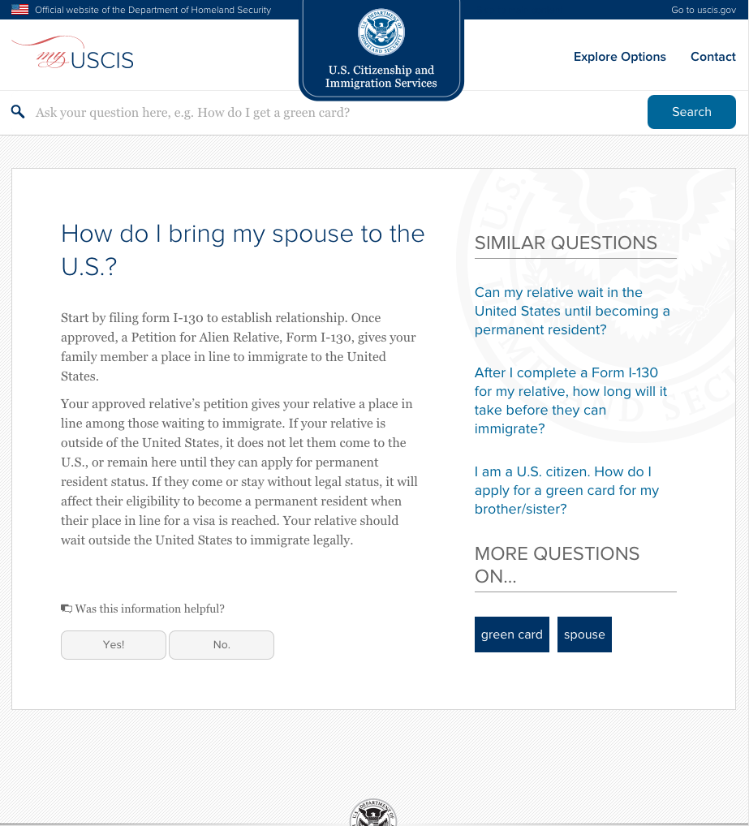

Slide 10
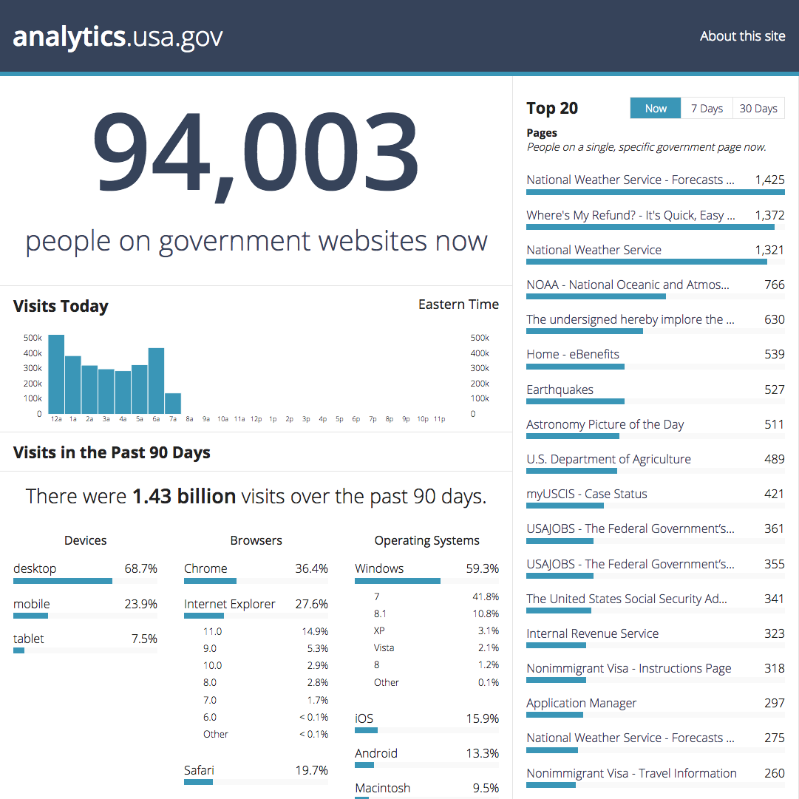

Slide 11
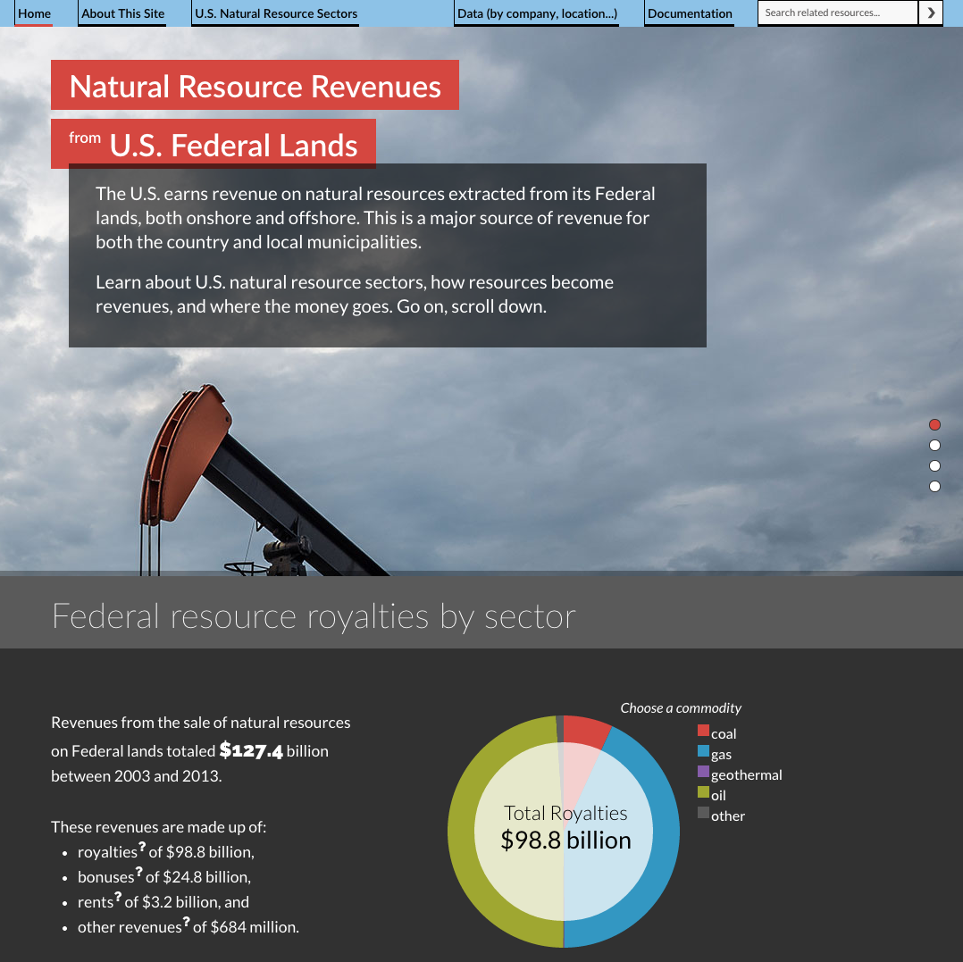
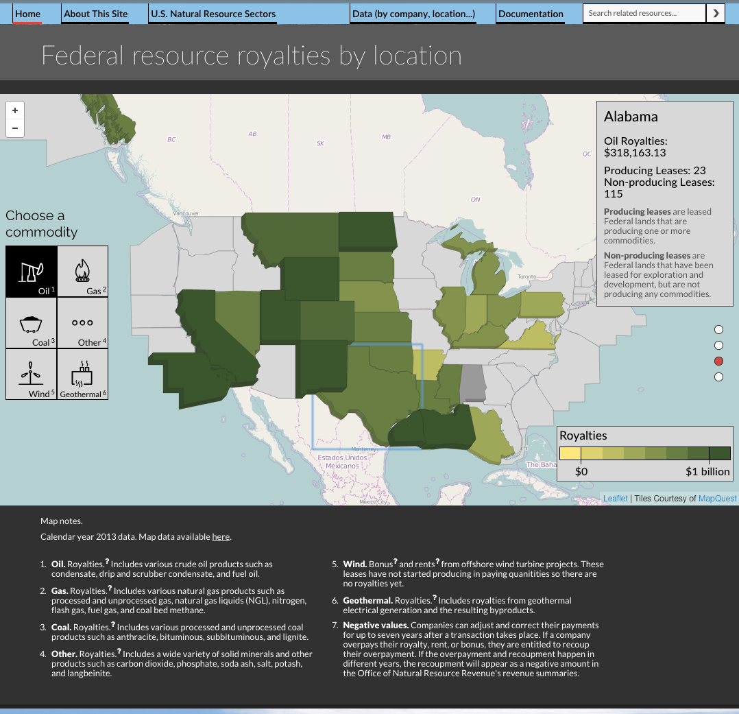

Slide 12
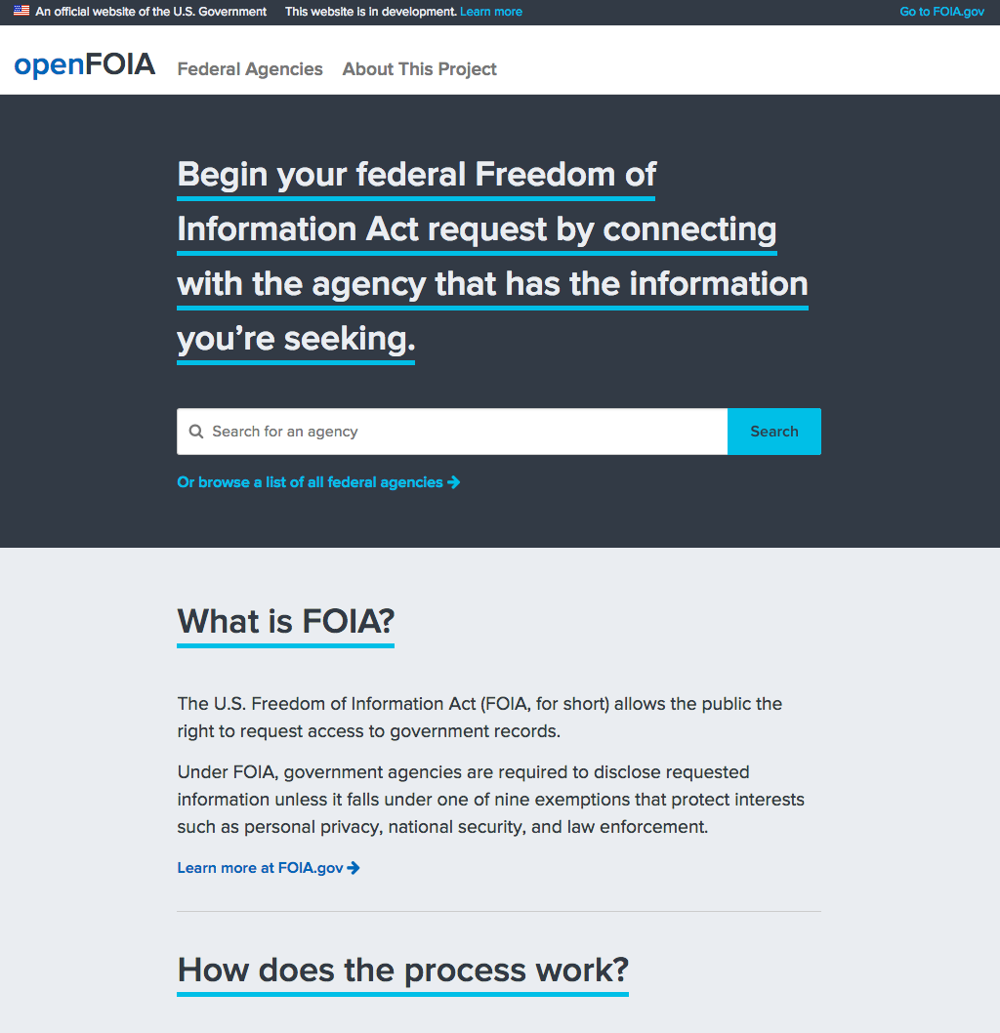
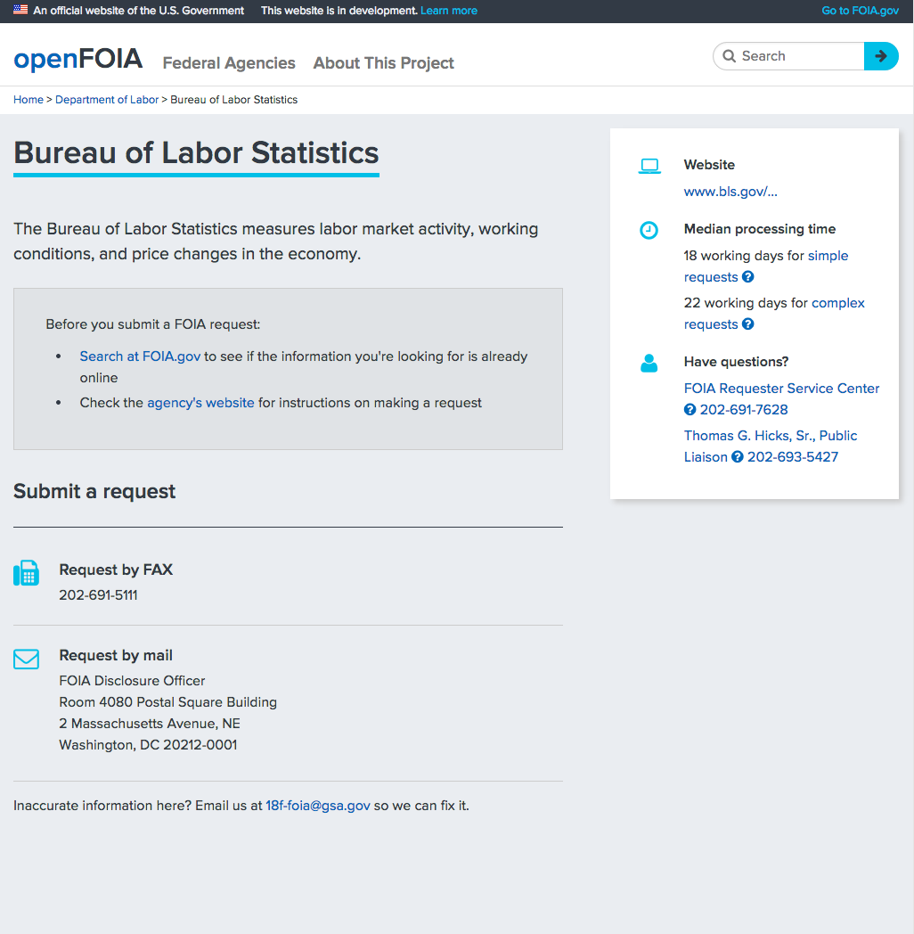

Slide 13
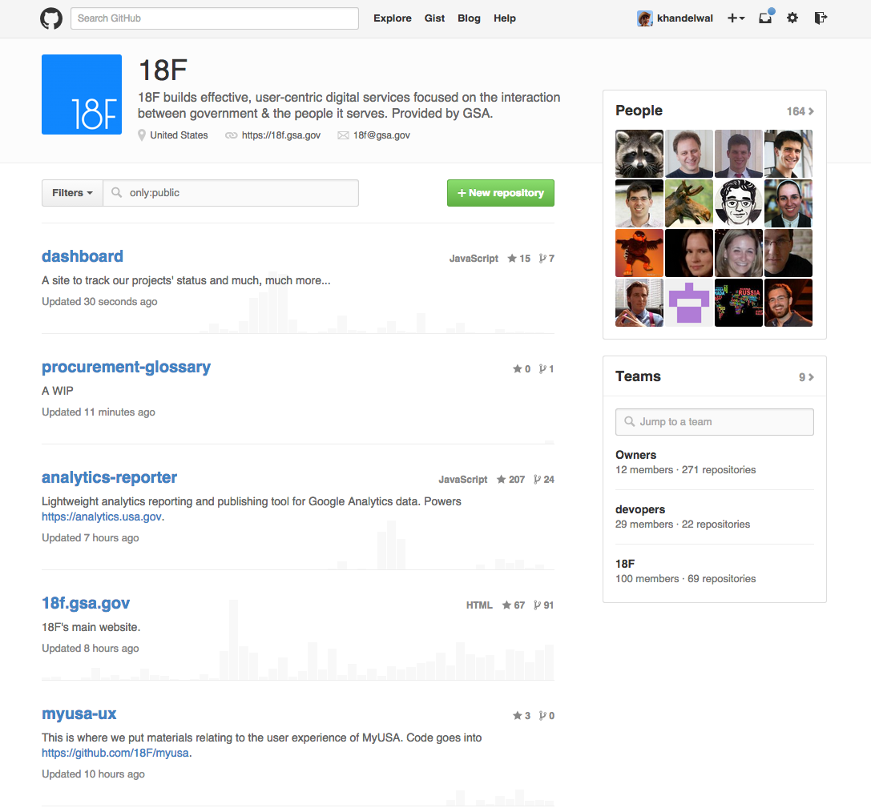
https://github.com/18F

Slide 14
18F Agile Guide

Slide 15
Define a measurable goal
Everyone owns the problem
Small steps with visible impact
Validate with your target audience
Measure success
Reflect, adjust, iterate

Slide 16
Define a measurable goal

Slide 17
“I believe this nation should commit itself to achieving the goal, before this decade is out of landing a man on the moon and returning him safely to earth. “

Slide 18
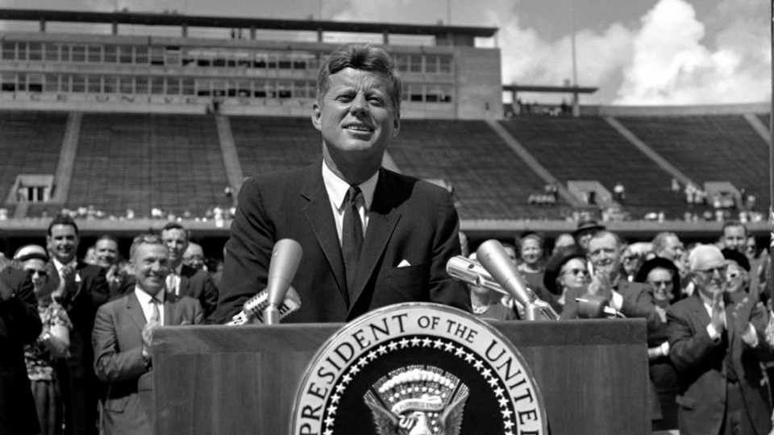

Slide 19
“I believe this nation should commit itself to achieving the goal, before this decade is out of landing a man on the moon and returning him safely to earth. “

Slide 20
Focus on your target audience.
Define them as narrowly as possible.

Slide 21
Envision a clear outcome
What’s the real world impact of my software?

Slide 22
Everyone owns the problem

Slide 23
Everyone on the team needs to understand who will use the product and why.

Slide 24
Hold regular design studios

Slide 25
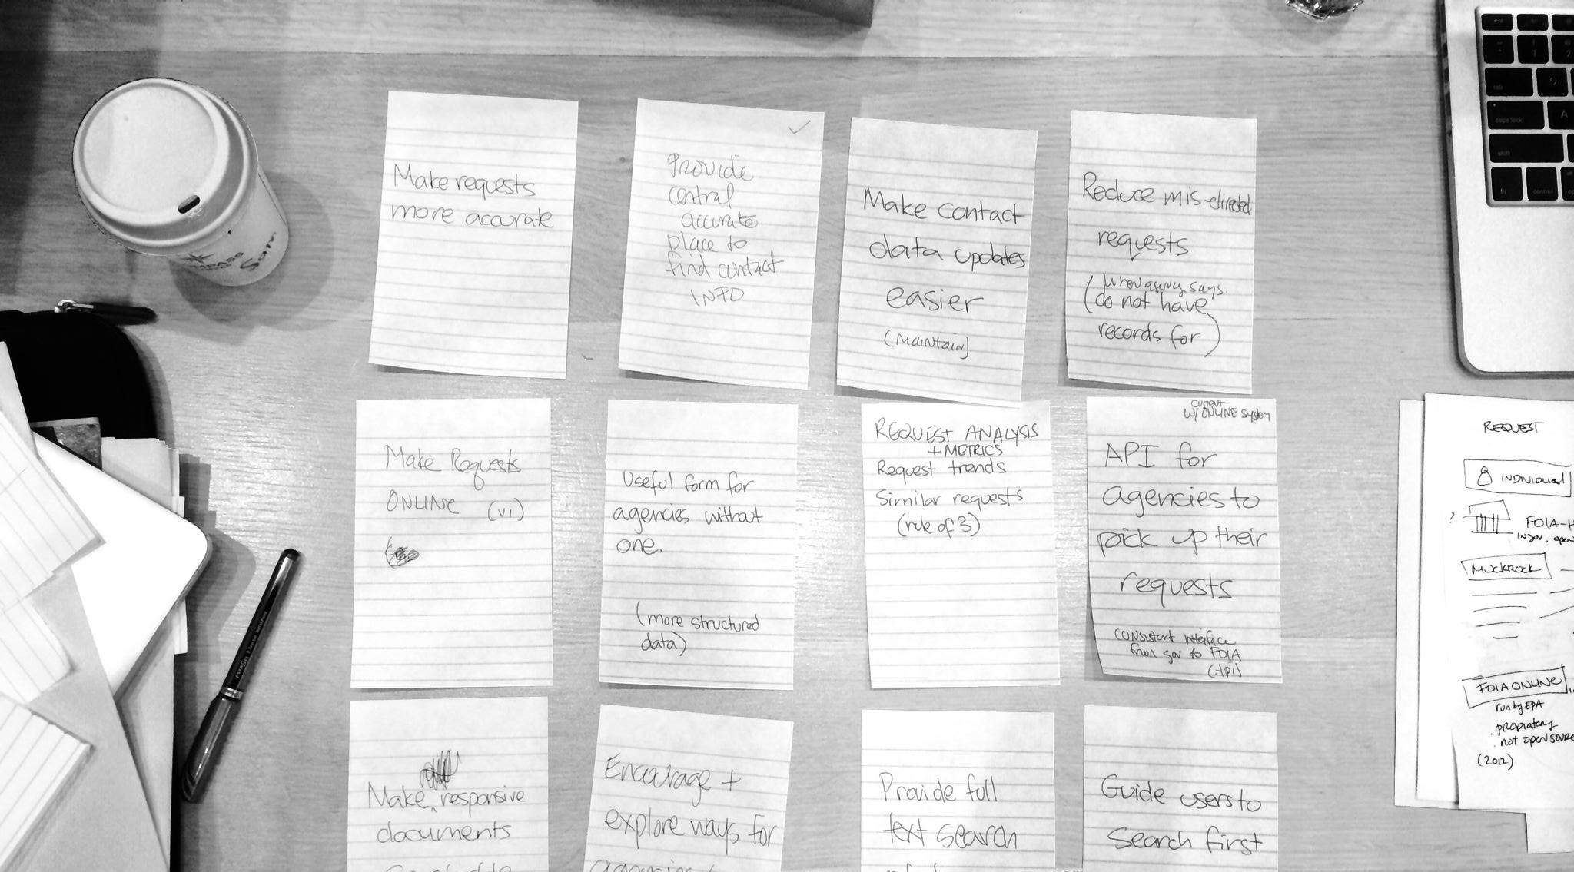
Choose a feature or small set of features

Slide 26
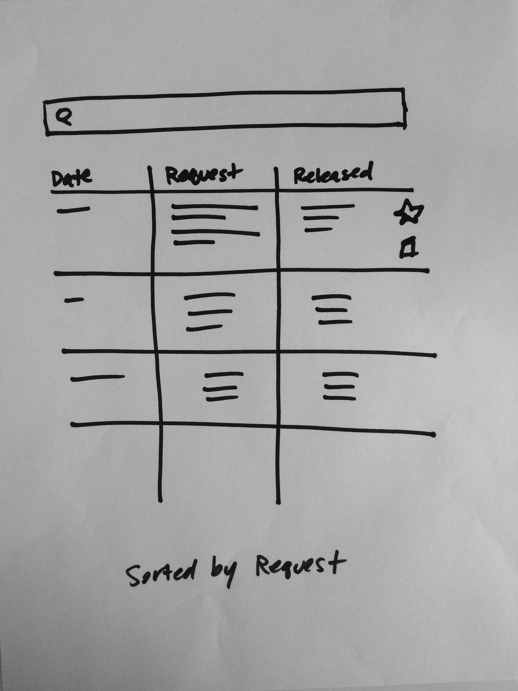
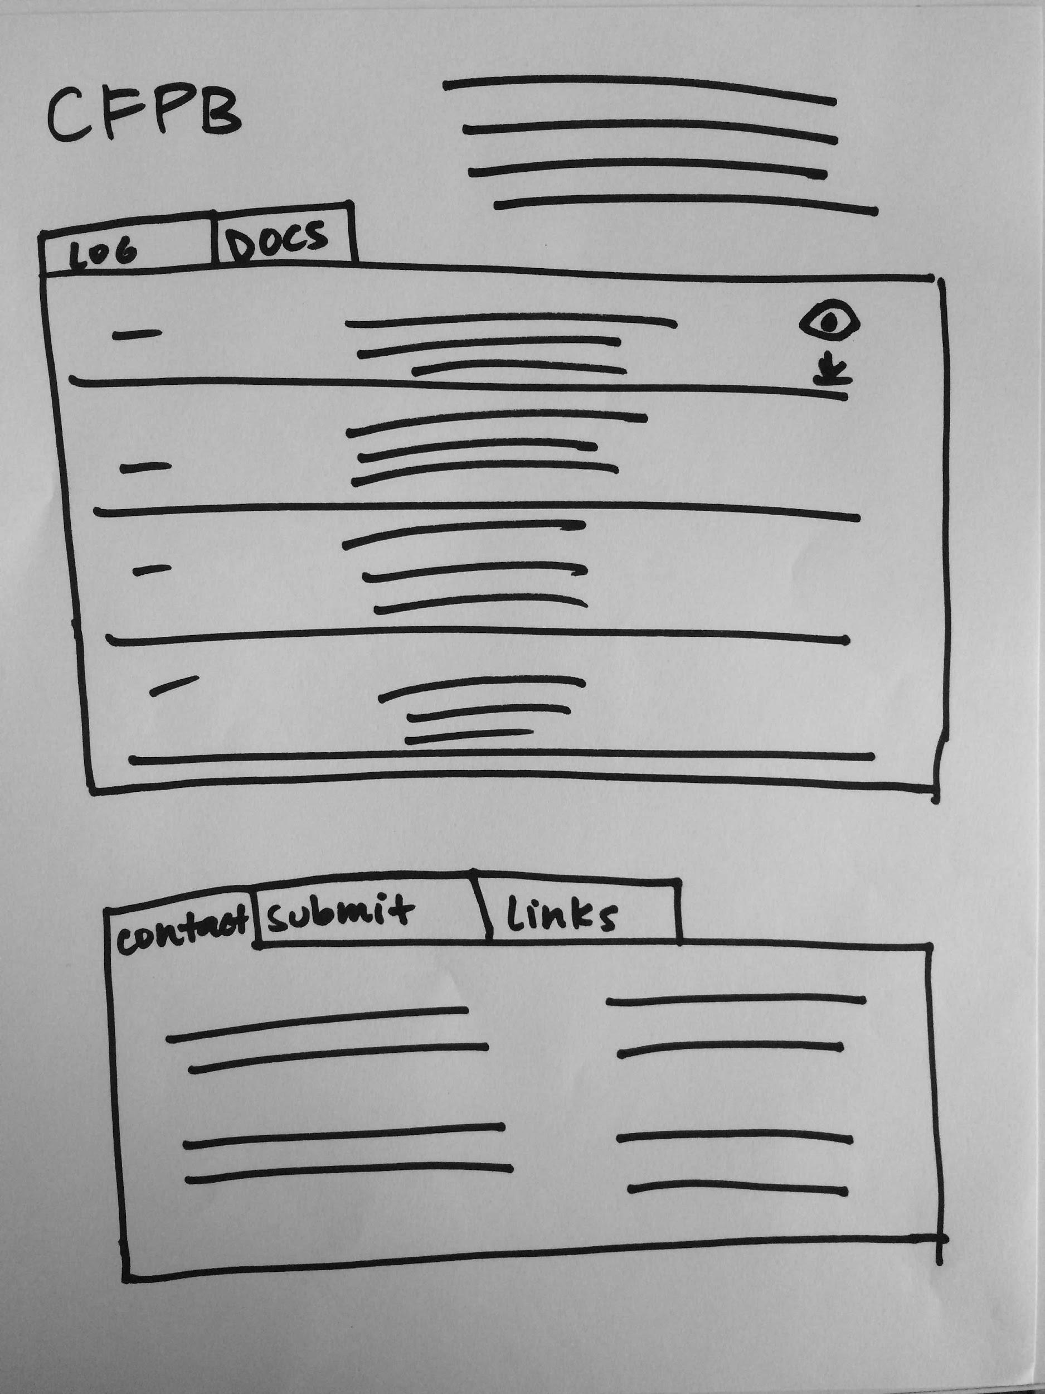
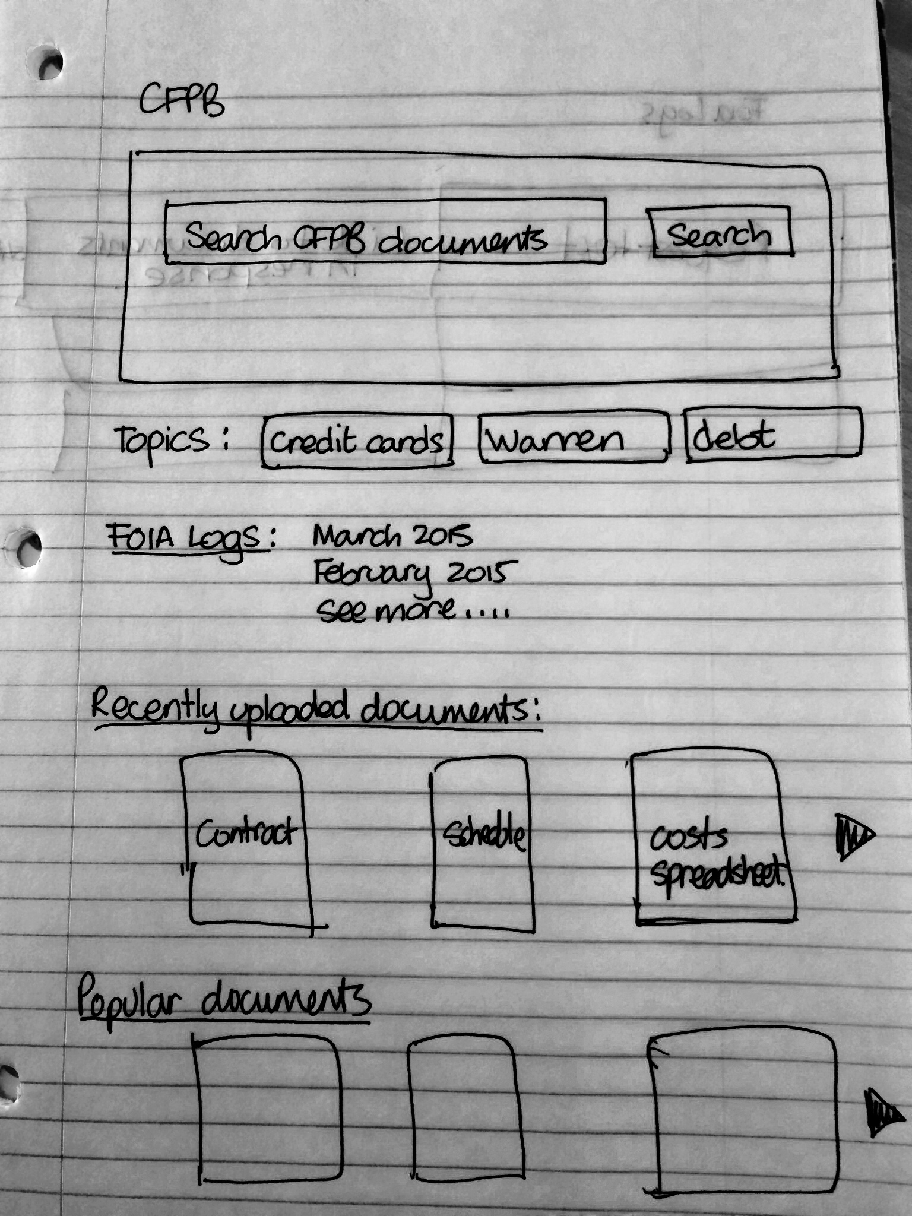
Everyone sketches their solution

Slide 27
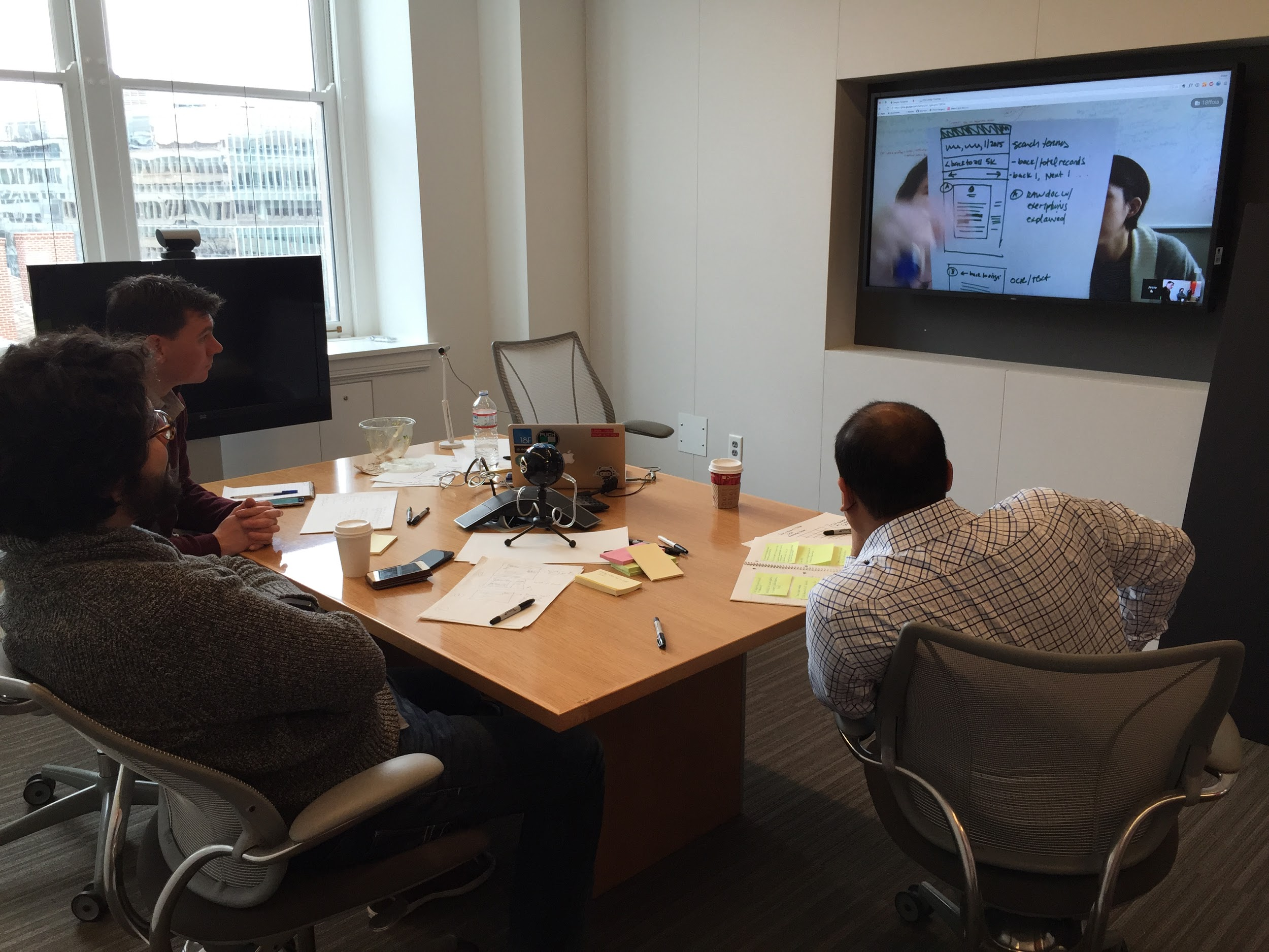
Discuss each sketch

Slide 28
Small steps forward

Slide 29
Focus
Build one thing at a time

Slide 30
Share with your stakeholders
Test with your users

Slide 31
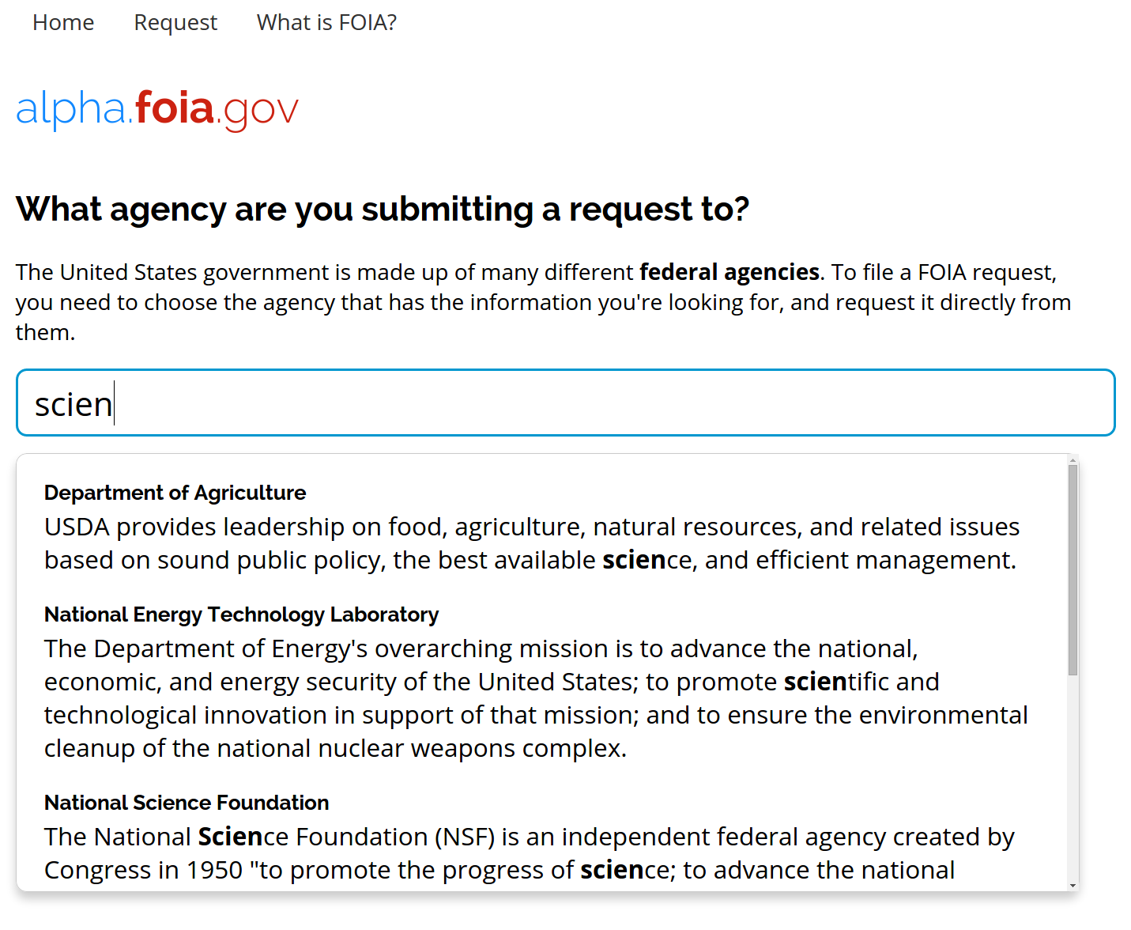

Slide 32
How do you decide what to build next?

Slide 33
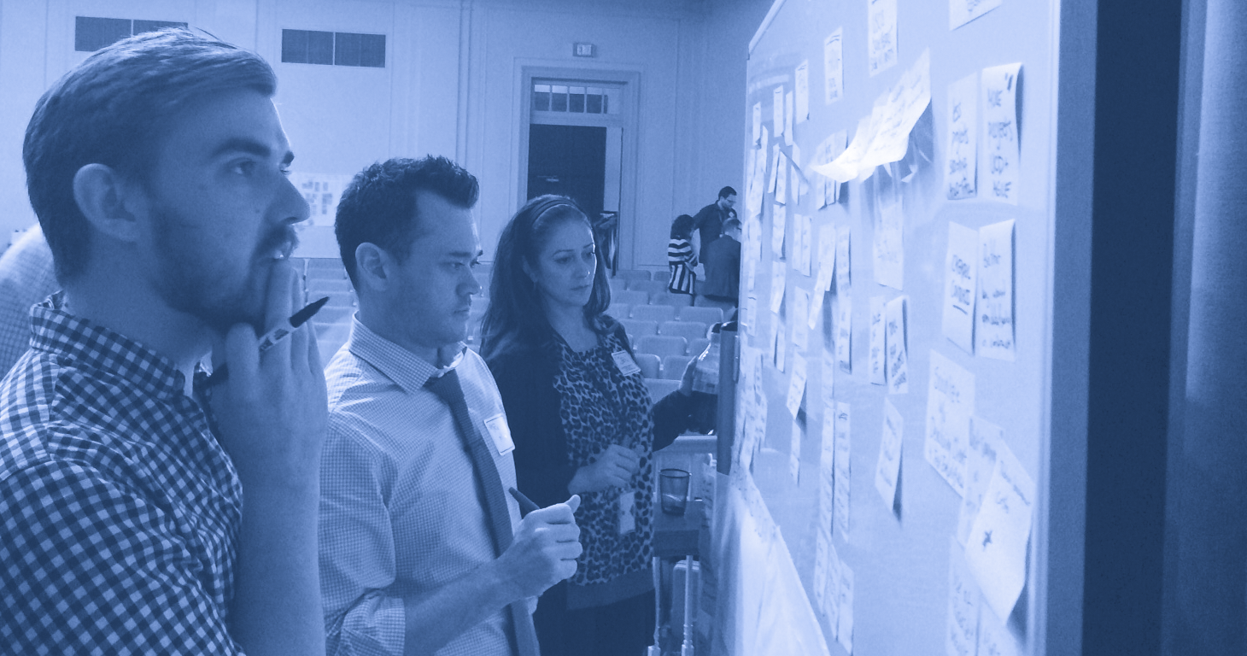
Create a backlog

Slide 34
Prioritize this backlog according to user needs

Slide 35
User needs, not bureaucrat needs

Slide 36
Items are added at any time
Higher priority items float to the top
Descriptions become clearer

Slide 37
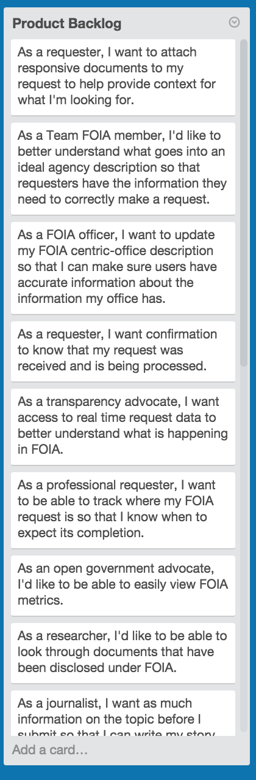
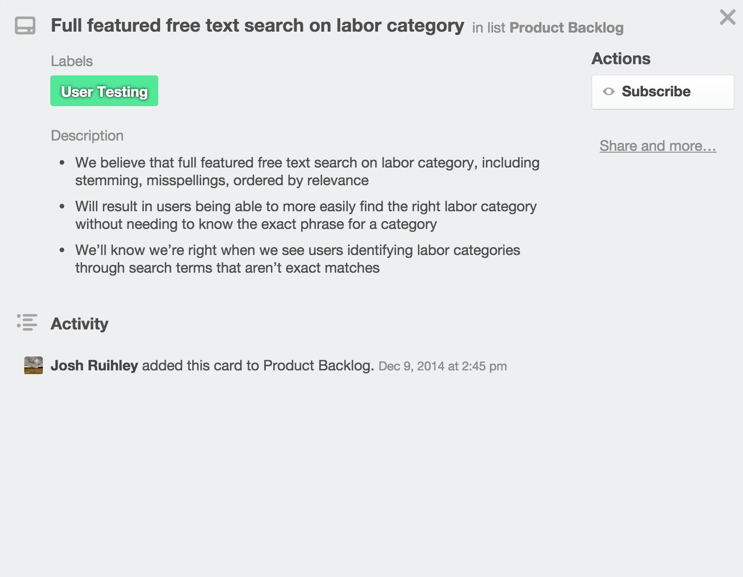

Slide 38
Build small
Test each piece with real users.

Slide 39
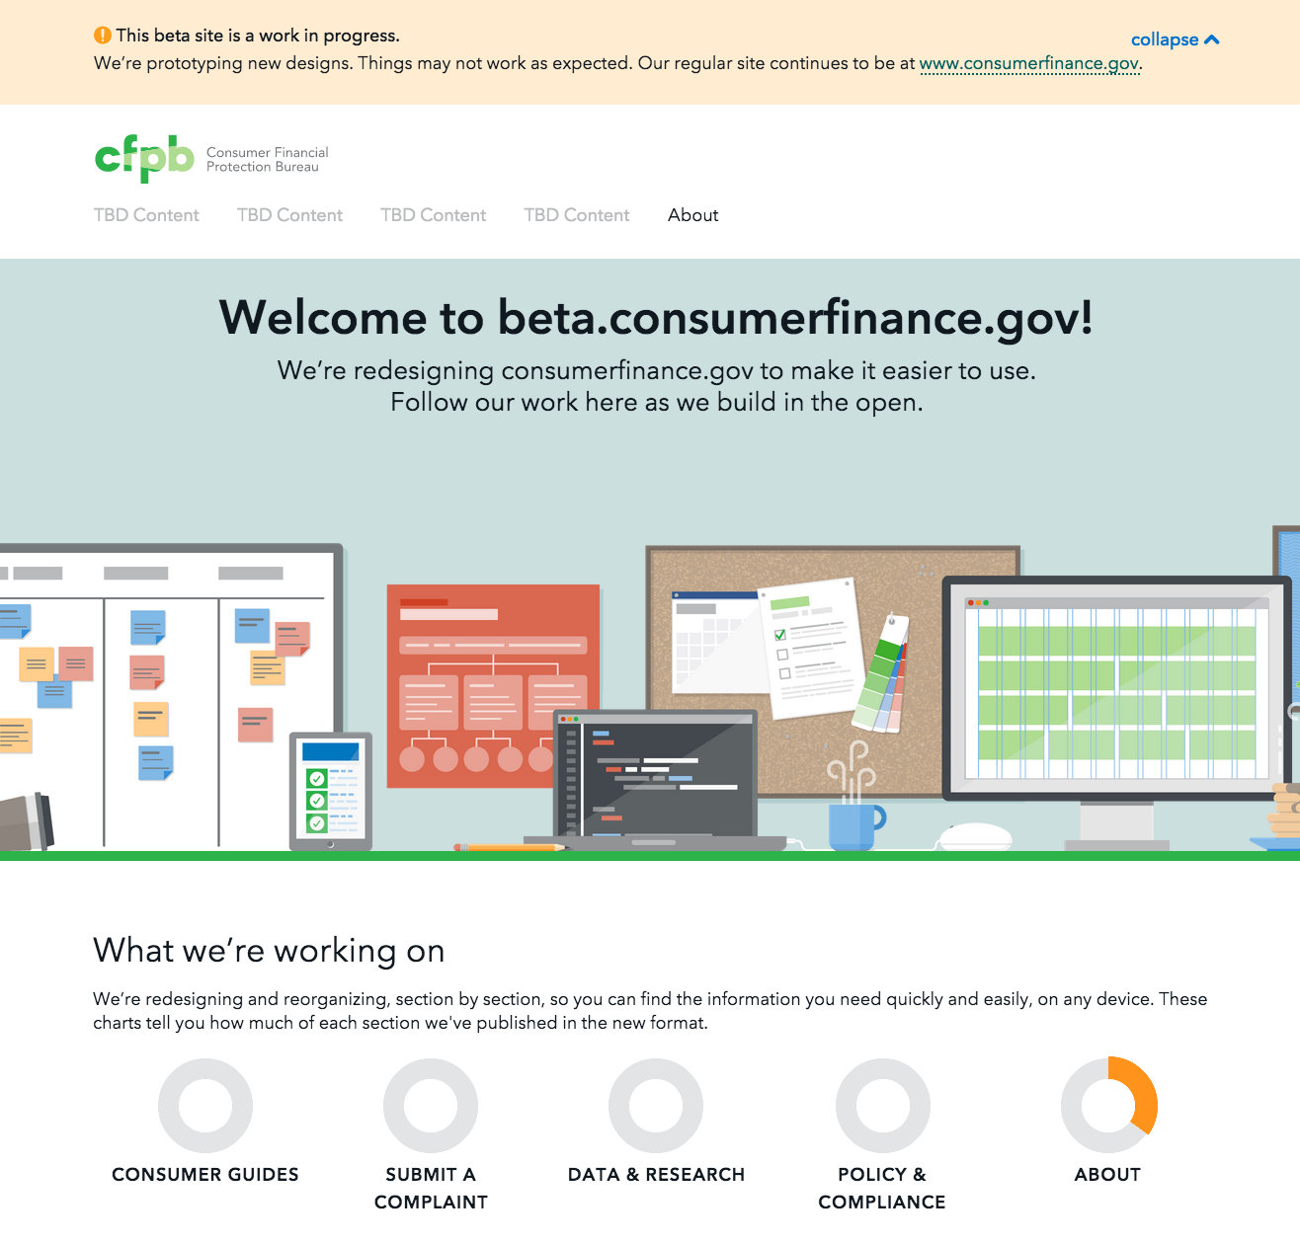

Slide 40
Validate with real users

Slide 41

Determine the real user of your product early

Slide 42
Conduct interviews, observe users as they go about their tasks

Slide 43
Aim to understand:
their goals needs and motivations
their emotions
their pain points

Slide 44
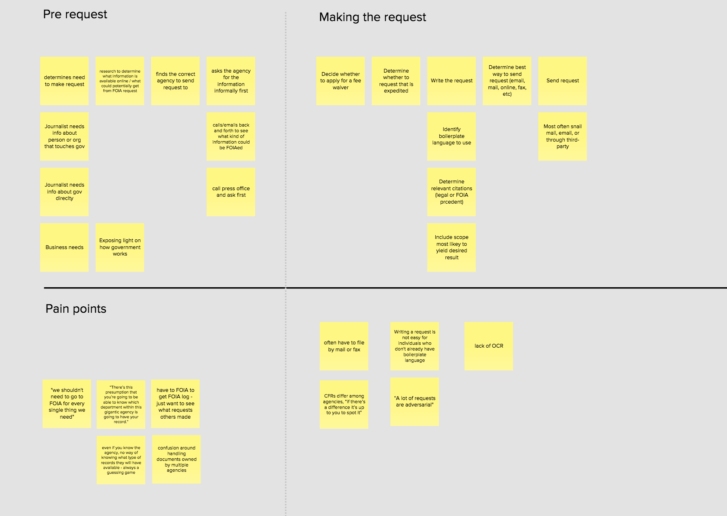
Journey map

Slide 45
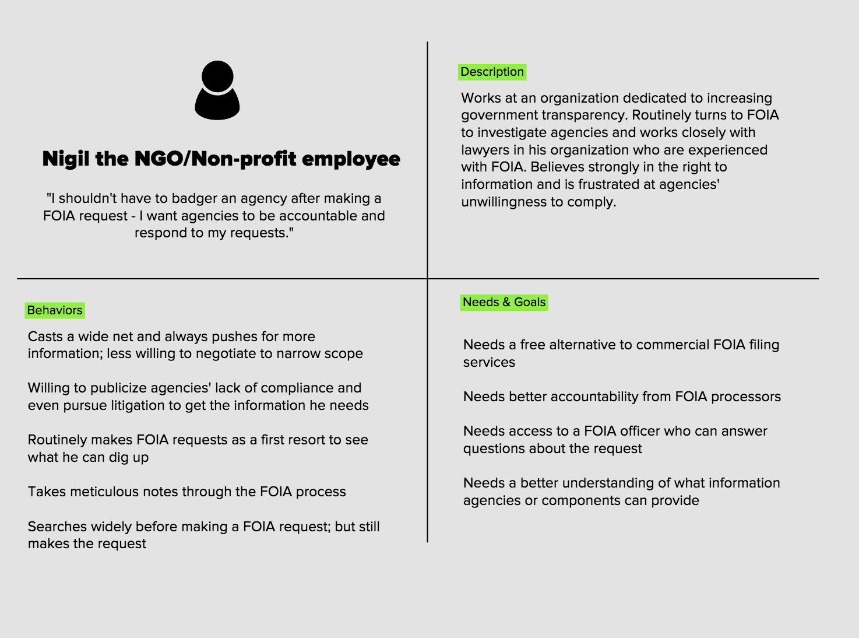
User persona

Slide 46
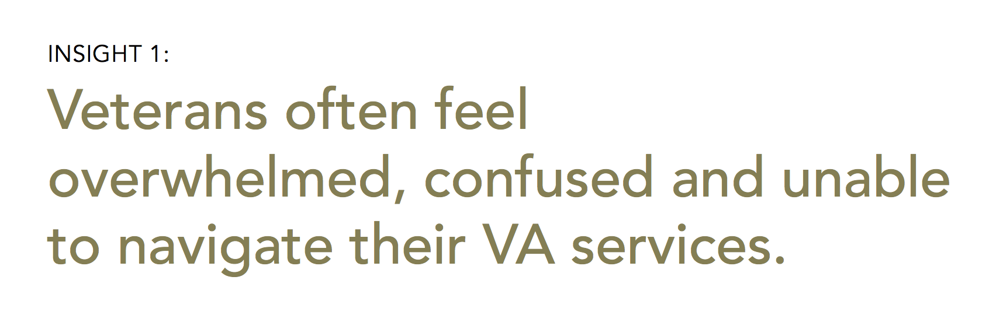

Slide 47
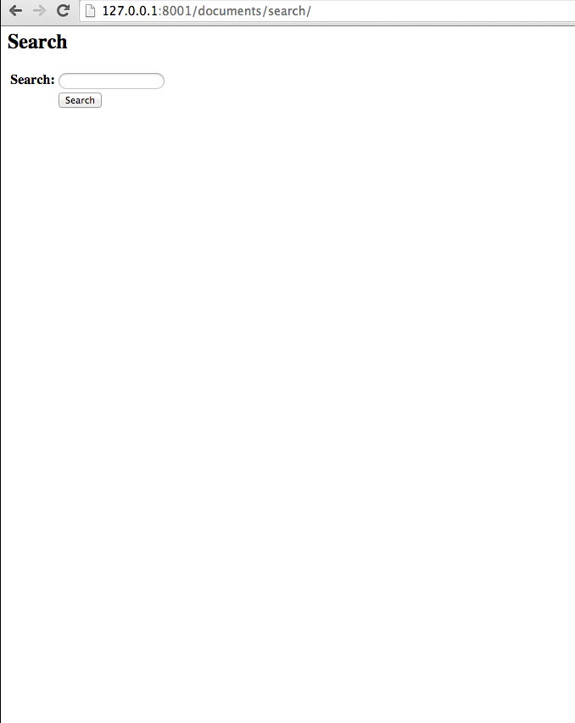
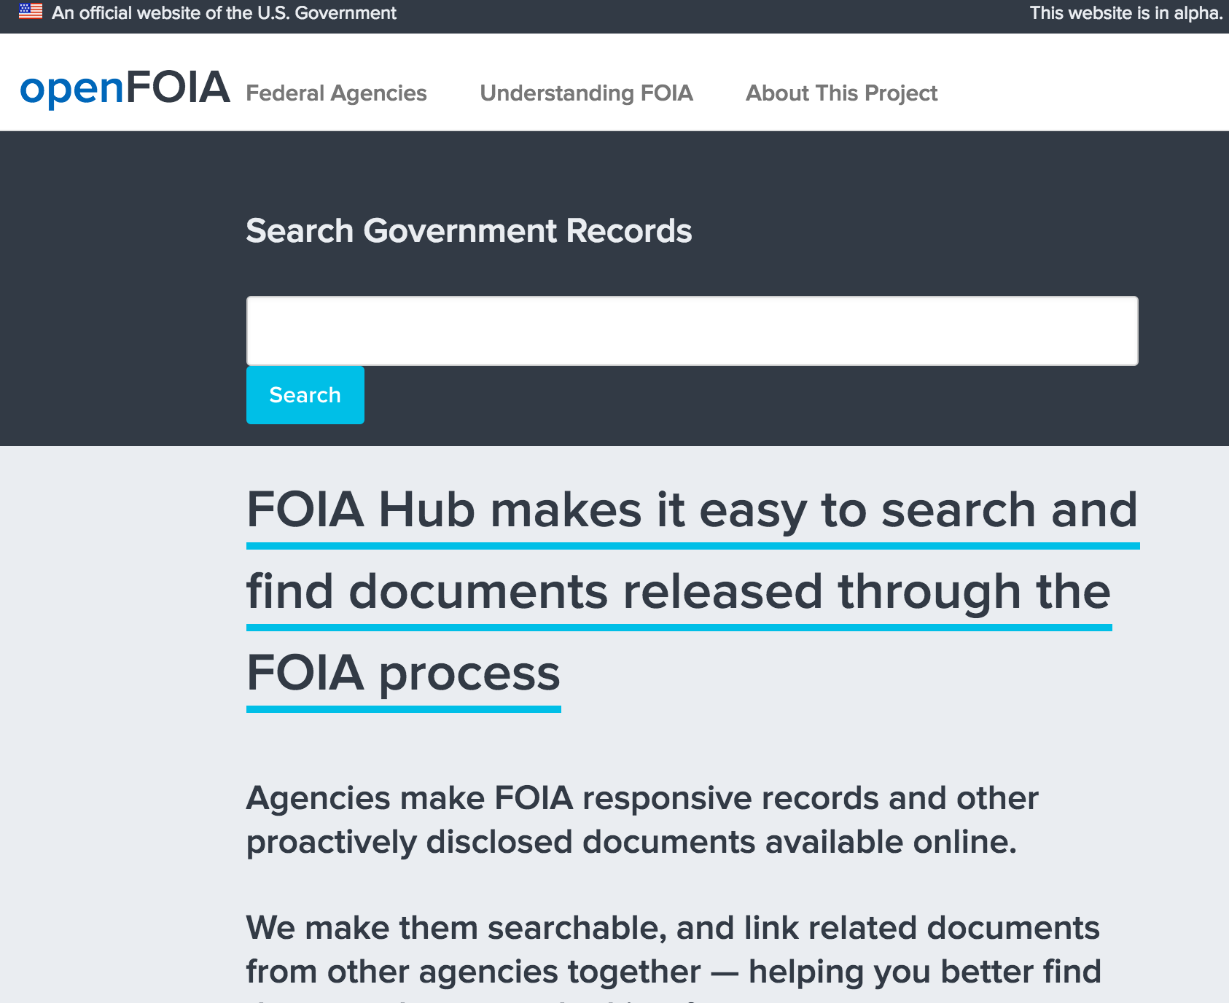
Always have a working product

Slide 48
Test as early and as often as possible with users

Slide 49
Measure Success

Slide 50
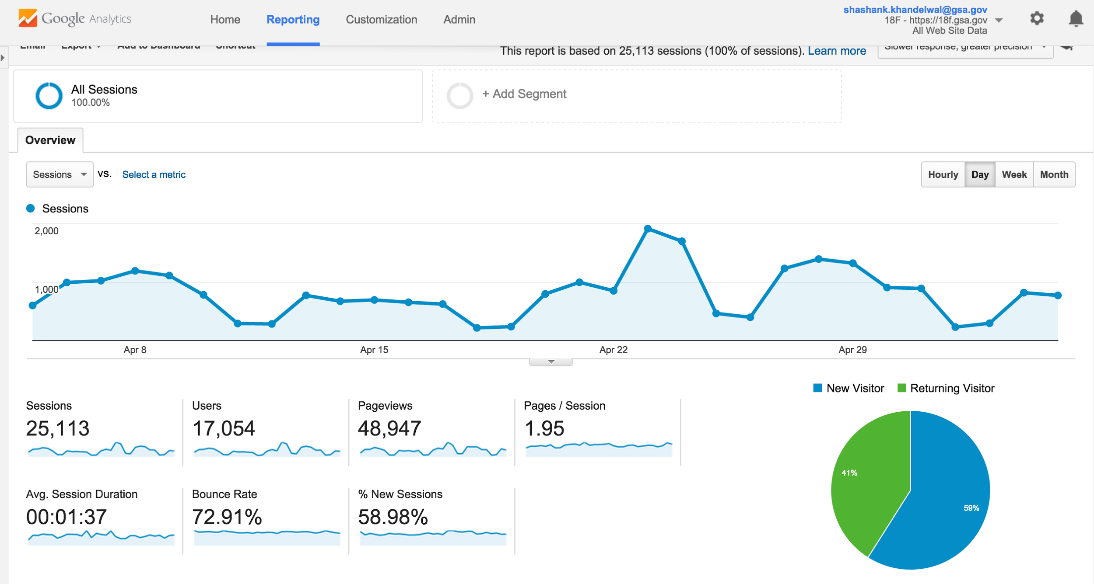
Define quantitative and qualitative metrics to measure success

Slide 51
“Raw number of comments (as compared to previous notices by the agency”

Slide 52
“Quality of new comments compared to quality of comments from previous periods”

Slide 53
Reflect, Adjust, Iterate

Slide 54
Stop
Start
Continue

Slide 55
Thank you.
@gazeti
shashank.khandelwal@gsa.gov

